Slide 1


Product recommendation analysis based on product attributes and reviews

Slide 2
Section 1
Problem Statement

Slide 3





The background to our problem is...
Whiskey product
Product purchased on the TWM website
Product tasted by the customer
Product is recommended further by the customer
Product gets ratings and reviews based on its quality, taste, etc.

Slide 4
Defining Problem Statement
Business Problem
Whenever a product is purchased, it receives a rating as well as a review by the customer on the product webpage based on several factors like its taste, price, quality, etc.
Based on its ratings and reviews, the product may or may not be recommended further.
Many a times, the recommendation details for a product are not available on the product webpage.
So, the main problem is to investigate the possible reason for the missing recommendation details and find a way to get the recommendation details for such products.
Solution proposed
We will analyze the details of the products such as price of the product, ratings and reviews provided to find the main reason behind missing recommendation details. Finally, we will apply different ML models to predict the recommendation percent for these products.

Slide 5
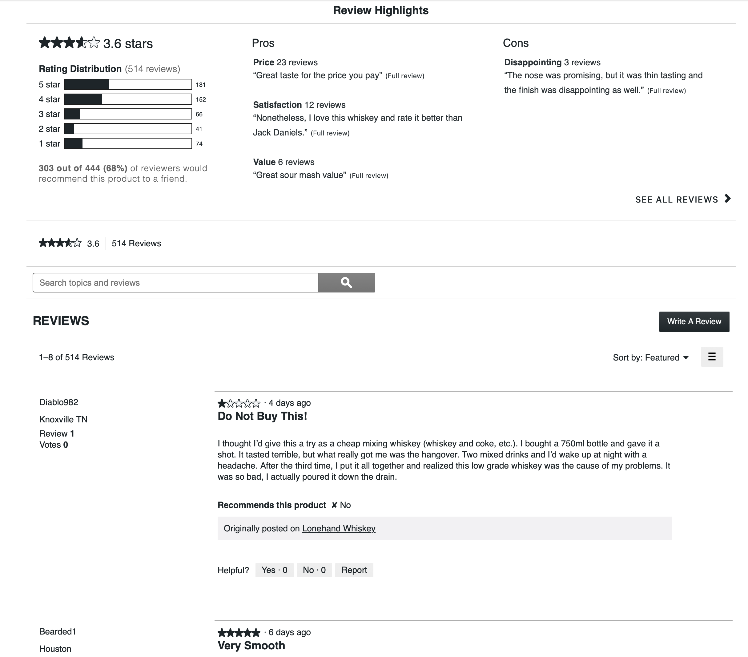
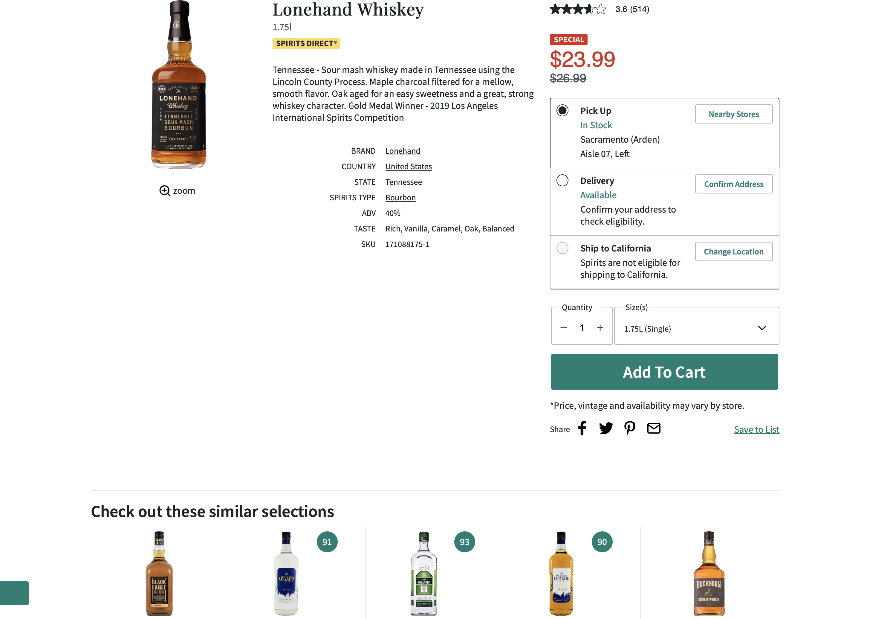
Web scrapping
Cons list
Average rating
Pros list
Product Name
Rating Distribution
Price per unit
Recommendation percent
Review title
Review text
Similar product details

Slide 6
About dataset
Basic details of the product
Rows = 1697
Independent variable
Columns = [Product name, Price per unit, top 5 similar product’s details ]
Rating details of the product
Rows = 1697
Independent variable
Dataset
(containing whiskey products only)
Columns = [Average rating, Rating count, Individual counts of 1–5-star ratings]
Reviews of the product
Rows = 1467
Independent variable
Columns = [Pros list, Cons list, Review text, Review title]
Recommendation details of the product
Rows = 1191
Dependent variable
Columns = [Recommendation percent, total recommendation count]

Slide 7
Section 2
Exploratory Data Analysis

Slide 8
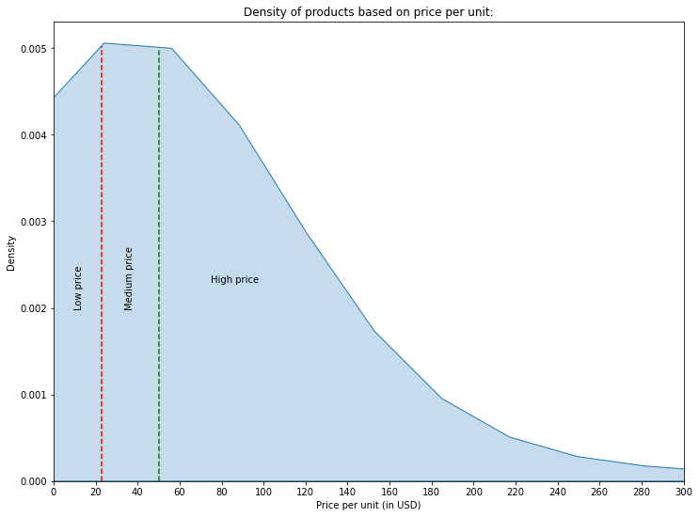
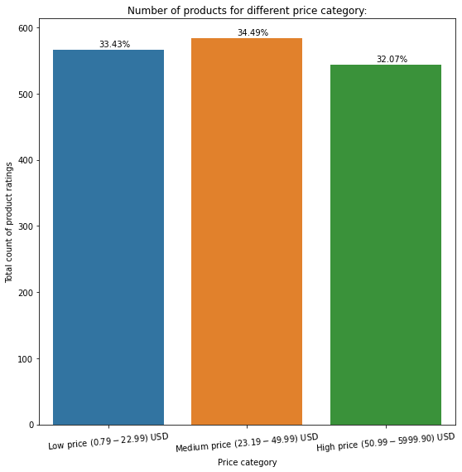
Distribution of price for different products:
Price per unit of whiskey products ranges from $0.79 to $5,999.90 which is further binned into 3 categories (Low price, Medium price, High price) such that total number of products within each category remains almost same.

Slide 9
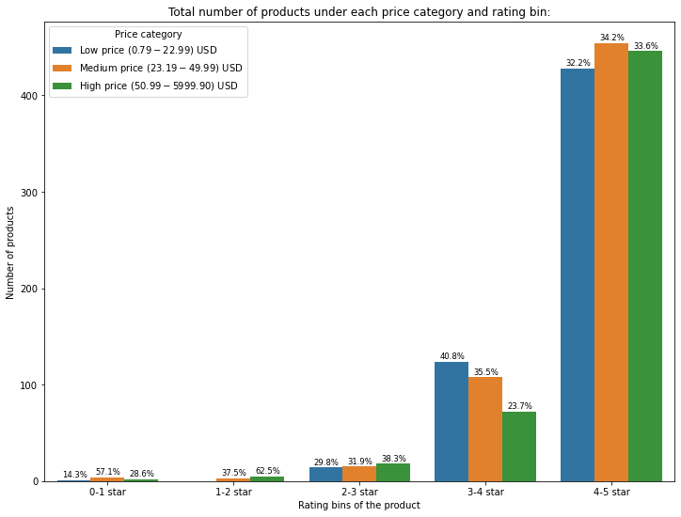
Distribution of products based on rating and price
Out of 1694 products, 78% of total products belong to 4-5 star rating category.
Almost 1632 (97%) products have rating >3 star , while average rating of all the products is around 4.39
In lower rating bins, high priced products have major contribution.

Slide 10
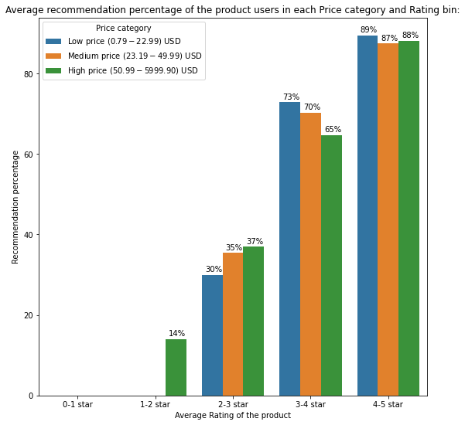
Variation of recommendation percent based on rating and price
The low-priced products with 3-4 and 4–5 star ratings were highly recommended compared to medium and high-priced products in the same rating bins.
In the low rated products, customers did not care to provide a recommendation feedback at all.
As the rating of the products decreased, recommendation percentage of the products also decreased, which tells about a correlation between the rating of the product and recommendation percentage.

Slide 11
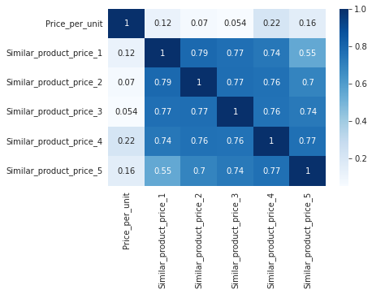
Similar products analysis
The following figure shows heatmap of correlation matrix for product price with price of similar products generated.
Based on the correlation value (max is 0.22) we can say that the similar products generated do not depend much on price.
Other hidden factors (not present on site) like department , category along with price maybe considered while generating recommendations.

Slide 12
Section 3
Data Preparation

Slide 13
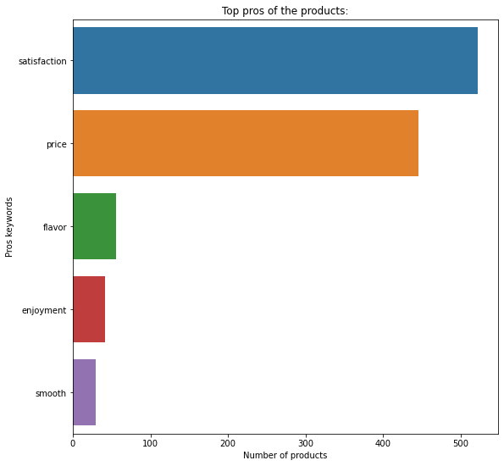
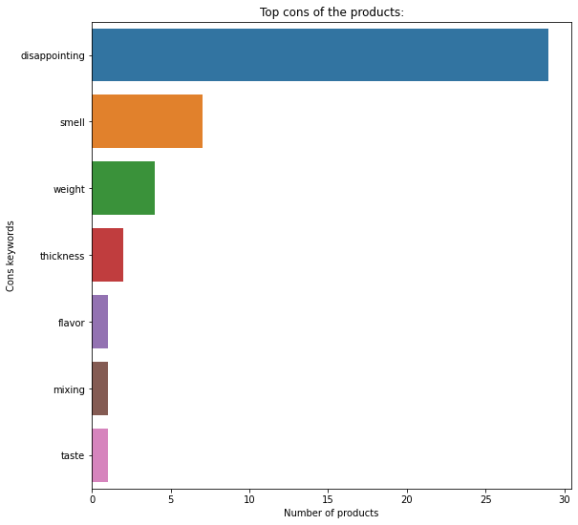
Pros and Cons
Pros keywords include words like satisfaction, price, flavor, etc. which shows that customers were satisfied with the price of the products and their flavor.
Cons keywords include words like disappointing, smell, weight, thickness, etc. which shows that some customers were disappointed with the smell of the products and their weight and thickness.

Slide 14
Review Text Cleaning
The text cleaning part consisted of following steps:
Original Text
Orignal
Lowering the text
“A great sipping whiskey neat, on ice or with a mix. I have been quite pleased.”
Word-Tokenize
Cleaned
Stop words removal
great sipping whiskey neat , ice mix . quite pleased
Clean Text

Slide 15
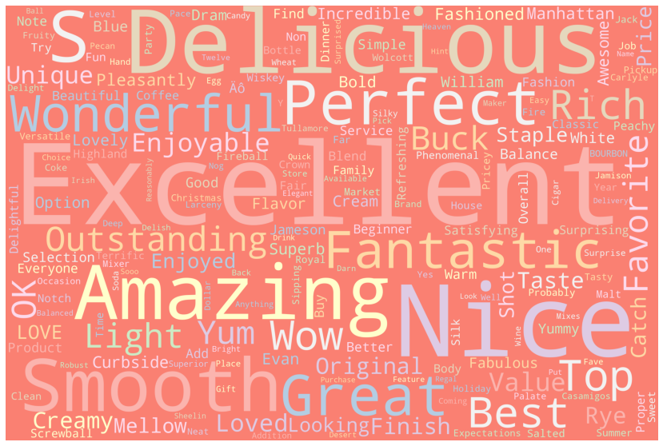
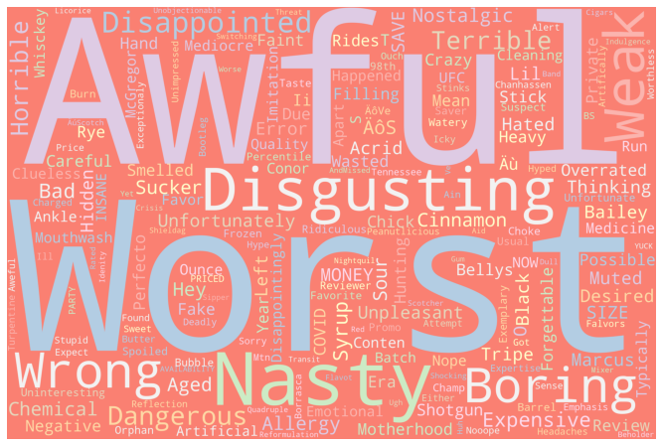
Sentiment analysis
Positive reviews keywords
Used “textblob” package on cleaned review text to generate sentiment score for all the reviews.
Averaged the sentiment scores of all reviews for a product for getting the final sentiment score for every product.
The number of products with negative final sentiment score was very less (almost 20 out of 1694 products) as compared to positive final sentiment products.
Negative reviews keywords

Slide 16
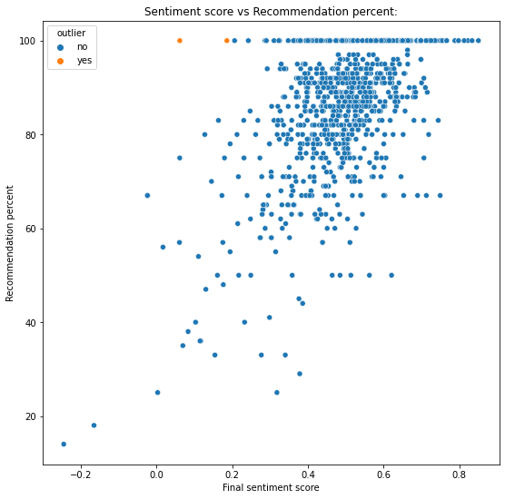
Sentiment score vs Recommendation percent
There is a positive correlation between the final sentiment score and the recommendation percentage of the product.
Majority of the products have recommendation percent more than 70%.
The products with negative sentiment score have very less recommendation percentage.
Despite having very low sentiment scores, these products have 100% recommendation:
Dimensions Laphroaig 21yr ($799.99)
Wilderness Trail Black Label Small Batch Bourbon ($39.99)

Slide 17
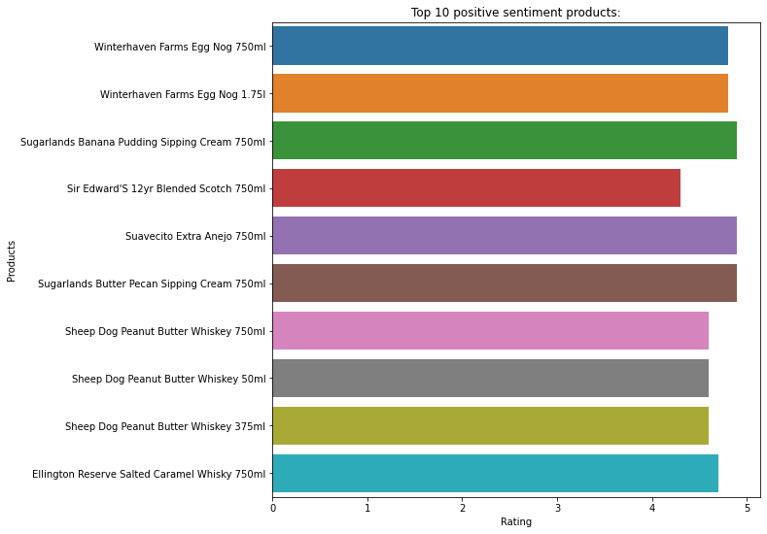
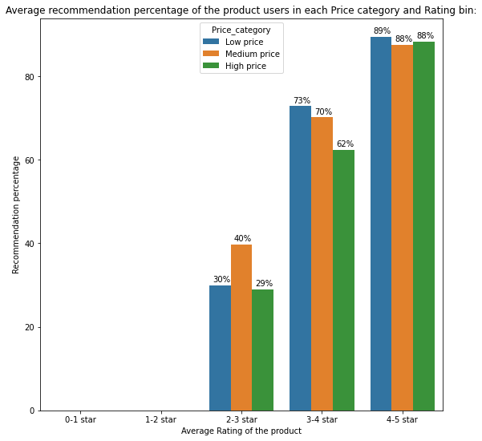
Positive Sentiment analysis
Top 10 positive sentiment products have rating more 4.5 stars.
For all the positive sentiment products whose rating is more than 4 star, the average recommendation percent is more than 85% i.e., these products are highly recommended by customers.
The recommendation percentage decreases as the rating of the product decreases.

Slide 18
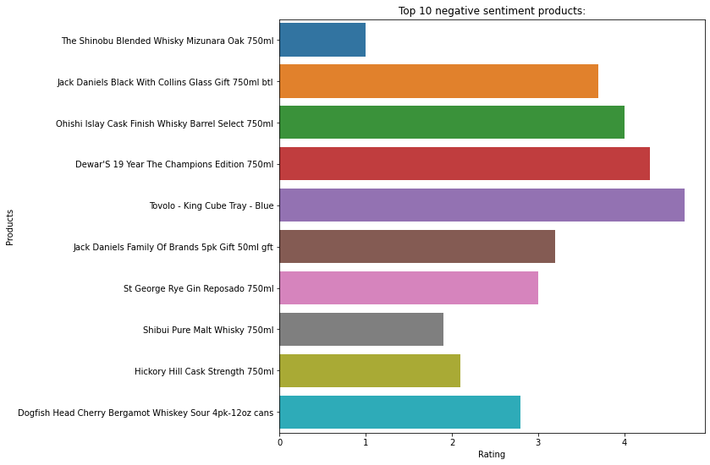
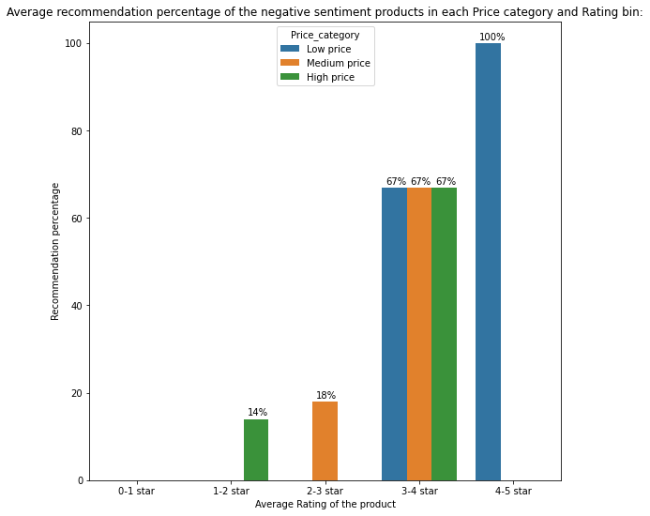
Negative Sentiment analysis
Most of the top 10 negative sentiment products have rating less than 4 star.
For negative sentiment products whose rating is less than 4 star, the maximum recommendation percent is less than 70%.
Many negative sentiment products do not have the recommendation flag which shows that people who dislike the product tend to not to answer the question, whether they would recommend the product or not.

Slide 19
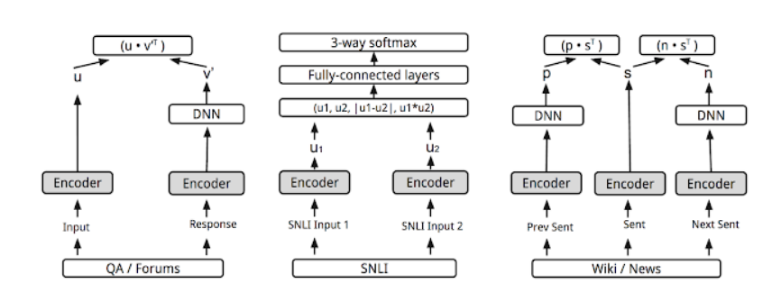
Word embeddings
Universal Sentence encoder (Google)
Used Universal Sentence Encoder by google on cleaned review text to generate word embeddings for all the reviews.
This encoder is based on two encoder models, and we can use either of the two:
Transformer
Deep Averaging Network(DAN)
The final sentence embedding contains 512 dimensions.

Slide 20
Section 4
Proposed Models &
Performance analysis

Slide 21
Different datasets for different levels of model
Level 1 : Data with basic details
Level 2 : Data with sentiment details
Level 3 : Data with review details & embeddings
Price per unit
Price per unit
Price per unit
Rating distribution
Rating distribution
Rating distribution
Sentiment score
Sentiment score
Pros list keywords and counts
Pros list keywords and counts
Cons list keywords and counts
Cons list keywords and counts
Review Word embeddings

Slide 22
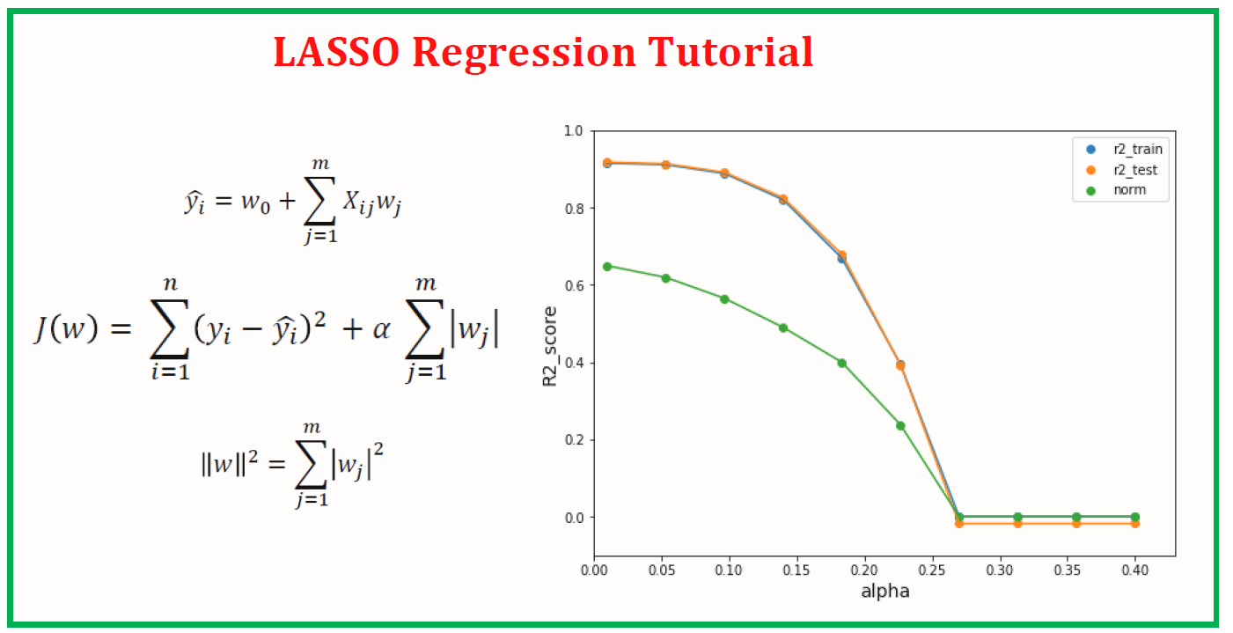
Lasso Regression
Model Performance
Model Introduction
→ Lasso regression is linear regression with L1 regularization
Data with embeddings
Data with basic details
Data with sentiment details
R2 score
0.08
R2 score
0.13
R2 score
0.82
Adj. R2 score
0.06
Adj. R2 score
0.09
Adj. R2 score
0.66
MAE
33.8
MAE
32.9
MAE
9.1
RMSE
37.9
RMSE
36.8
RMSE
17.2

Slide 23
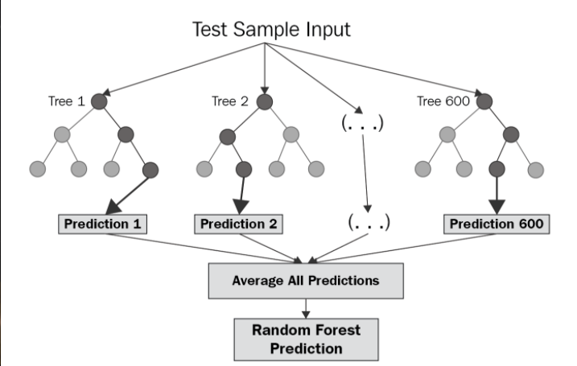
Random forest Regression
Model Performance
Model Introduction
Data with basic details
Data with sentiment details
Data with embeddings
R2 score
0.52
R2 score
0.92
R2 score
0.93
Adj. R2 score
0.50
Adj. R2 score
0.91
Adj. R2 score
0.85
MAE
18.4
MAE
7.06
MAE
6.72
RMSE
27.6
RMSE
11.14
RMSE
10.80

Slide 24
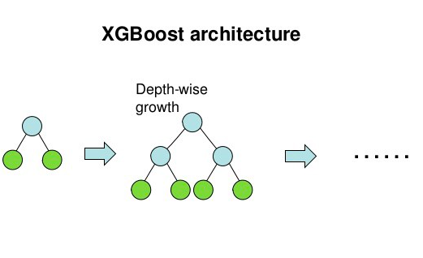
XGBoost Regression
Model Performance
Model Introduction
Data with basic details
Data with sentiment details
Data with embeddings
R2 score
0.51
R2 score
0.95
R2 score
0.96
Adj. R2 score
0.49
Adj. R2 score
0.95
Adj. R2 score
0.92
MAE
16.14
MAE
4.90
MAE
5.1
RMSE
27.9
RMSE
8.40
RMSE
8.18

Slide 25
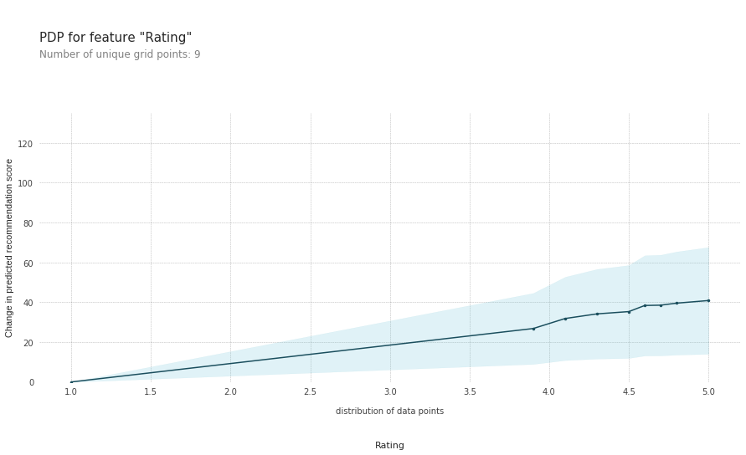
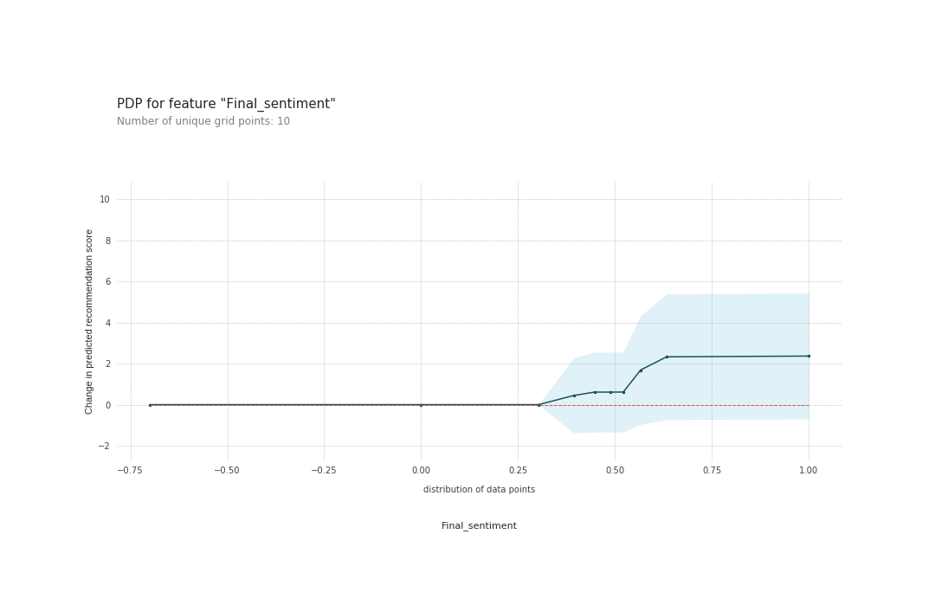
PDP for Rating & Final sentiment score
The Partial Dependence plots for features are generated using the best performing XGBoost regressor model.
Increase in average rating of product leads to continuous increase in recommendation percent when the rating crosses the baseline threshold of “1 star rating”.
Recommendation percent also increases when the sentiment score of the reviews (generated from sentiment analysis), crosses the threshold score of 0.25.

Slide 26
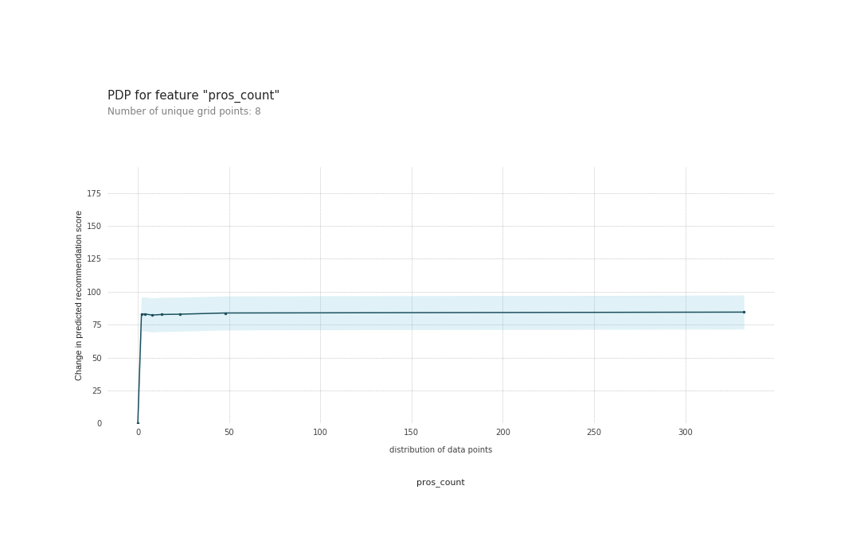
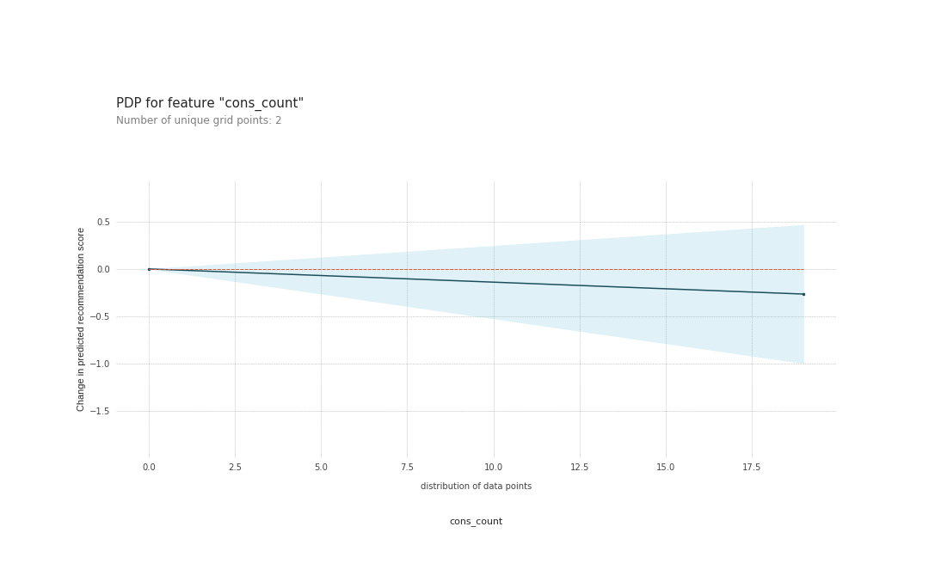
PDP for Pros count & Cons count
Increase in number of pros reviews for a product leads to rapid increase in recommendation percent .
But if number of pros reviews goes beyond 15 the increment is almost constant.
On the other hand , the recommendation percent decreases slowly as number of cons reviews increase beyond 0.

Slide 27
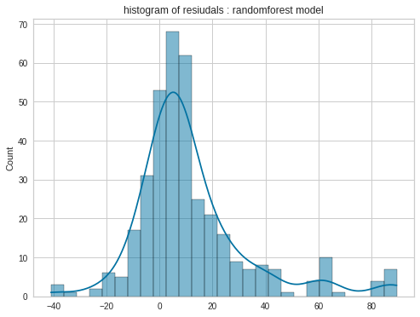
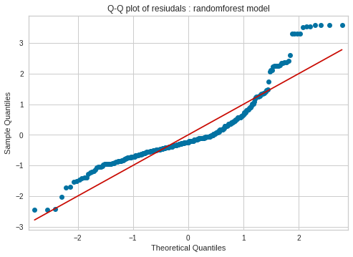
Model Interpretation for Level 1 dataset
On the dataset with basic details, the Random forest regressor model has better performance in terms of accuracy metrics.
Based on Q-Q plot & histogram of residuals , we can interpret that the residuals approximately follow a normal distribution.

Slide 28
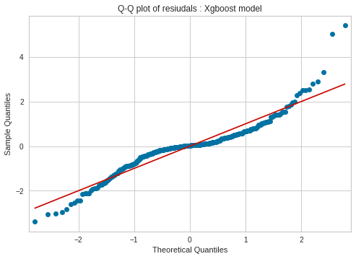
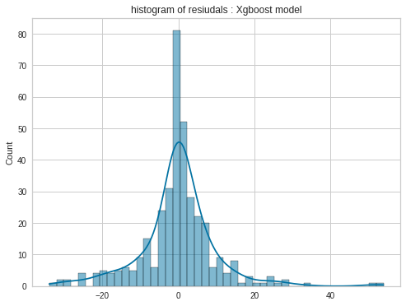
Model Interpretation for Level 2 dataset
The Q-Q plot & Histogram of residual values generated by XGBoost regressor on the dataset with sentiment details is plotted.
Based on that, we can interpret that the residuals are randomly distributed & approximately follow a normal distribution.

Slide 29
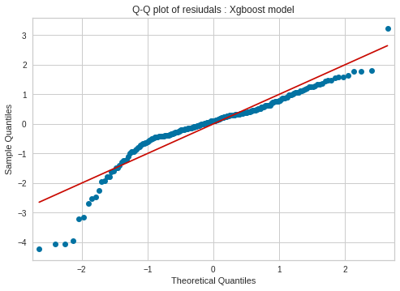
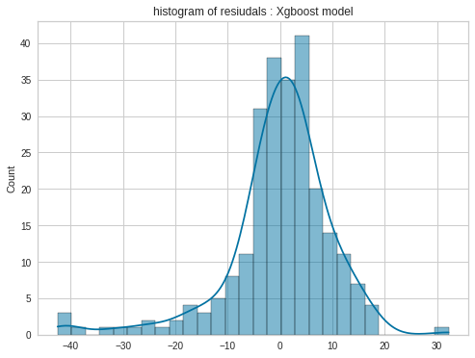
Model Interpretation for Level 3 dataset
The Q-Q plot & Histogram of residual values generated by XGBoost regressor on the dataset with embeddings is shown.
Based on that, we can interpret that the residuals approximately follow a normal distribution.
As the residuals are randomly distributed & follow a normal distribution the XGBoost model is better compared to other models.

Slide 30
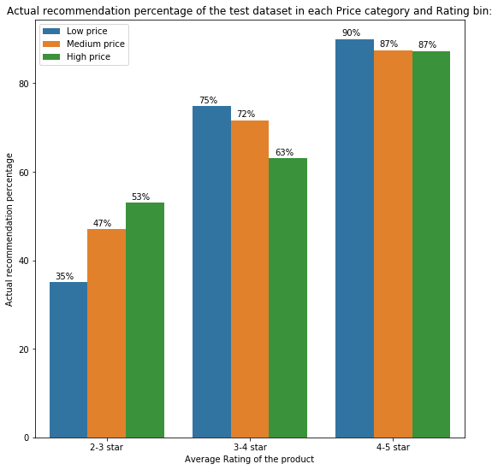
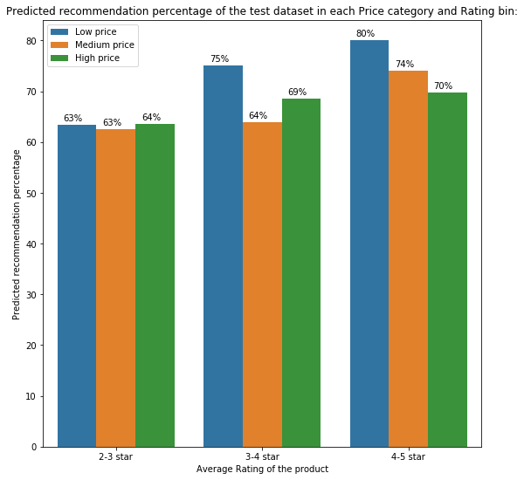
Results – Level 1 dataset
The model (Random Forest regressor) was tested on the test data (basic details) set and the predictions had an average recommendation score of 73.3% while actual average recommendation score was 84.3%.
The model works comparatively good for predicting the recommendation percentage of 3-4 star rating products.
The performance of the model drastically declines for the products with lower ratings (2-3 star) as the predicted percentages are much higher than actual recommendation percentage.

Slide 31
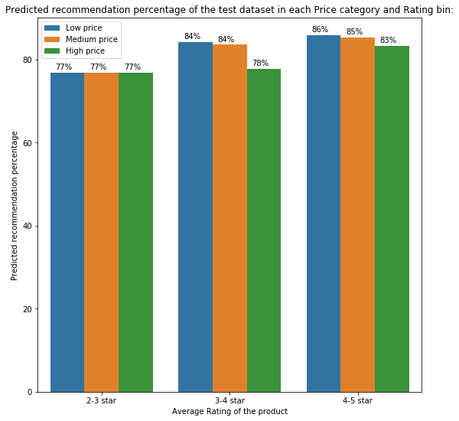
Results – Level 2 dataset
The model (XGBoost regressor) was tested on the test data set (with sentiment details) and the predictions had an average recommendation score of 84%.
There is negligible difference from actual average recommendation percent of test dataset.
The model works good for predicting the recommendation percentage of high rating products (4-5 star).

Slide 32
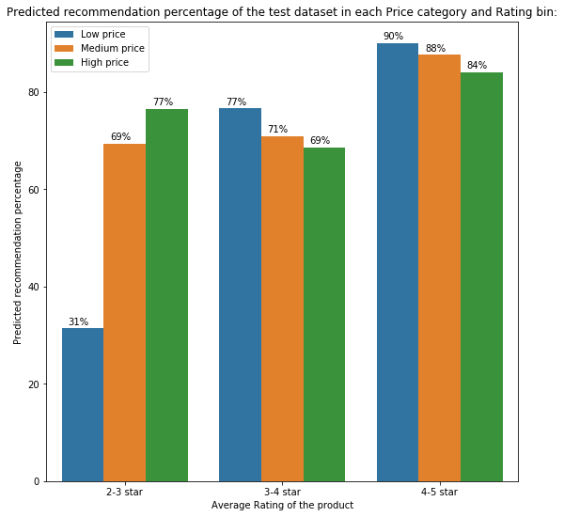
Results – Level 3 dataset
The model (XGBoost regressor) was tested on the test data set (with embeddings).
Here also, there is negligible difference from actual average recommendation percent of test dataset.
The model works good for predicting the recommendation percentage of products with ratings 3-4 and 4-5 star.
Out of all the 3 models, model with level 3 dataset performs better compared to other levels.

Slide 33
Section 5
Conclusion

Slide 34
Conclusion & Business aspects
Based on the reviews, ratings of various users for different products, this model predicts recommendation score which gives even more clear picture compared to manual recommendation feedback given by customers.
Based on that, we can decide whether to spend resources on those or, should we concentrate on other revenue generating products.
Also, we can analyze the sales of low rated (0-2 stars) products which are significant in number and take further steps to improve its sales if possible.
As recommendation score for some products is very low, we can analyze the number of sales & revenue for these products.

Slide 35
Section 6
Learnings & Future Possibilities

Slide 36
Future Improvements
With larger dataset and expanding it to other types, DL & NLP state of art models can be used for more fruitful results and recommendation can be improved for products with lesser reviews.
Based on other details of product like categories, department etc., we can generate an initial recommendation score for newly launched products so that customers can get an idea about it.
With even more expanded dataset & customer information, we can provide personalized recommendation for different users.

Slide 38
Appendix A : Details of other models

Slide 39
Lasso Regression
Model Introduction
Model Performance
→ Lasso regression is linear regression with L1 regularization
Data without embeddings
Data with embeddings
R2 score
0.13
R2 score
0.82
Adj. R2 score
0.09
Adj. R2 score
0.66
MAE
32.9
MAE
9.1
RMSE
36.8
RMSE
17.2

Slide 40
Random Forest Regression
Model Introduction
Model Performance
Data without embeddings
Data with embeddings
R2 score
0.92
R2 score
0.93
Adj. R2 score
0.91
Adj. R2 score
0.85
MAE
7.06
MAE
6.72
RMSE
11.14
RMSE
10.80

Slide 41
XGBoost Regression
Model Performance
Model Introduction
Data without embeddings
Data with embeddings
R2 score
0.95
R2 score
0.96
Adj. R2 score
0.95
Adj. R2 score
0.92
MAE
4.90
MAE
5.1
RMSE
8.40
RMSE
8.18

Slide 42
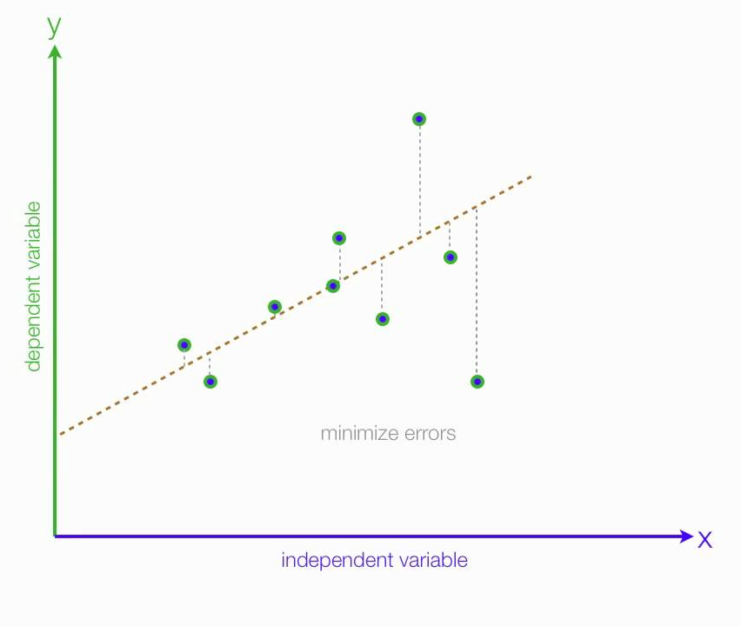
Linear Regression (OLS)
Model Introduction
Model Performance
Data without embeddings
Data with embeddings
R2 score
0.13
R2 score
0.75
Adj. R2 score
0.09
Adj. R2 score
0.59
MAE
33.1
MAE
11.1
RMSE
36.8
RMSE
19.5

Slide 43
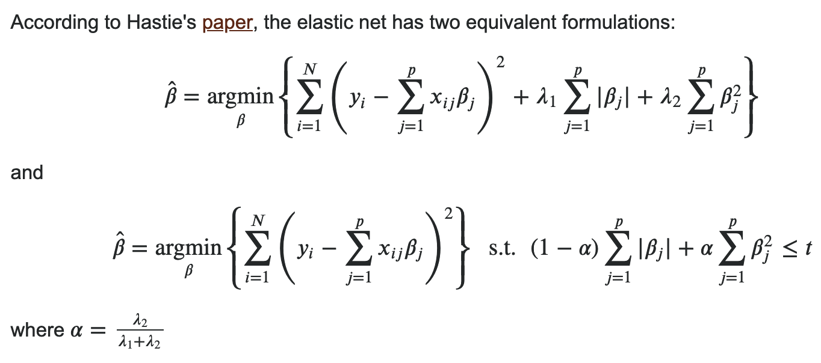
Elastic Net Regression
Model Introduction
Model Performance
→ Elastic Net is linear regression with both L1 & L2 regularizations together
Data without embeddings
Data with embeddings
R2 score
0.13
R2 score
0.64
Adj. R2 score
0.09
Adj. R2 score
0.39
MAE
32.9
MAE
17.6
RMSE
36.9
RMSE
23.7

Slide 44
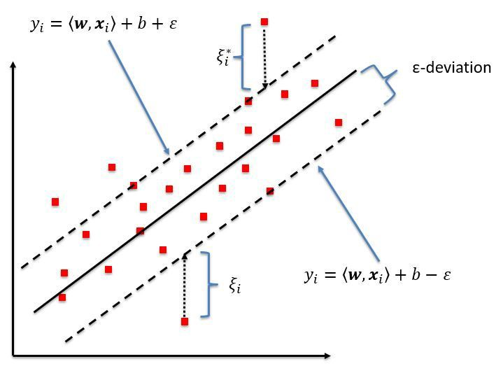
SVM Regression
Model Introduction
Model Performance
Data without embeddings
Data with embeddings
R2 score
0.01
R2 score
0.13
Adj. R2 score
-0.01
Adj. R2 score
-0.42
MAE
27.8
MAE
26.6
RMSE
31.4
RMSE
36.9

Slide 45
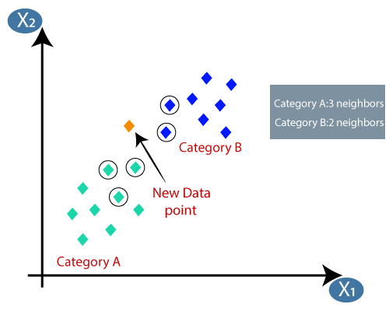
KNN Regression
Model Introduction
Model Performance
Data without embeddings
Data with embeddings
R2 score
0.37
R2 score
0.32
Adj. R2 score
0.34
Adj. R2 score
0.18
MAE
17.6
MAE
19.9
RMSE
31.8
RMSE
33.9

Slide 46
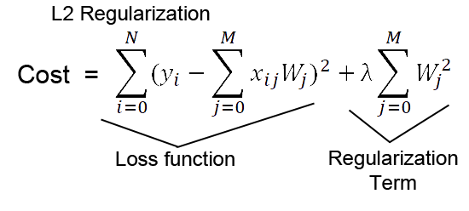
Ridge Regression
Model Introduction
Model Performance
Data without embeddings
Data with embeddings
→ Ridge regression is linear regression with L2 regularization
R2 score
0.13
R2 score
0.76
Adj. R2 score
0.09
Adj. R2 score
0.59
MAE
33.1
MAE
10.8
RMSE
36.8
RMSE
19.2

Slide 47
Appendix B : PDP plots for various features

Slide 48
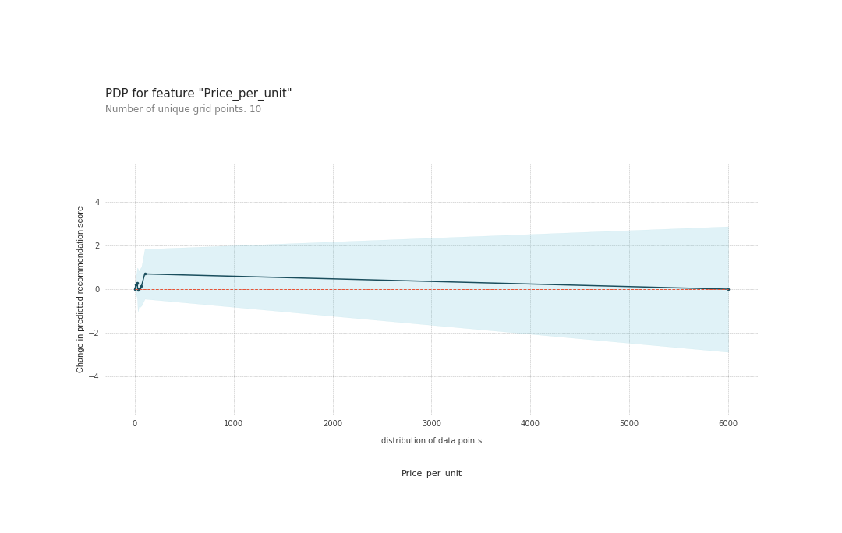
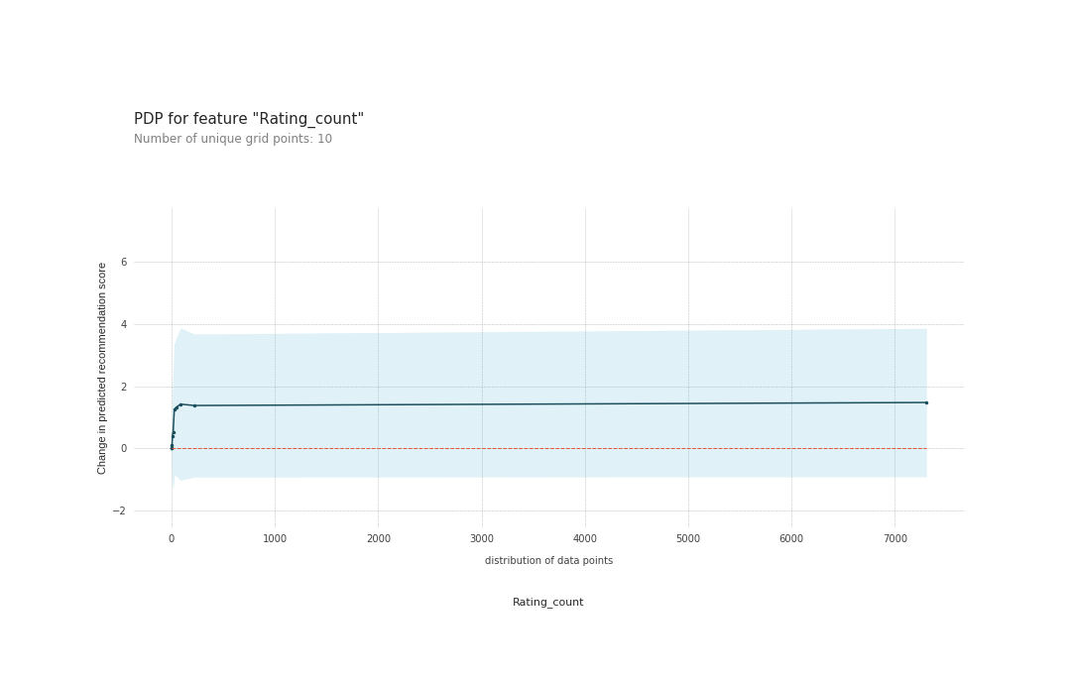
PDP for price & reviews count
Recommendation percent rapidly increases till price equals 200 $ and then slowly decreases beyond that price.
Also, as no. of ratings are more(means more people have bought it) , higher the recommendation percent.
Based on dependency of recommendation score on product price, we can interpret that people recommend the products based on quality but not solely based on price to recommend the product.

Slide 49
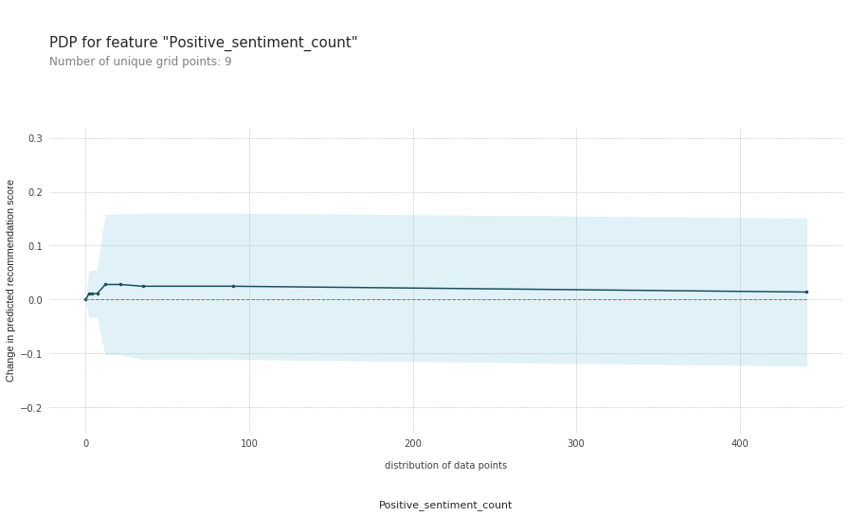
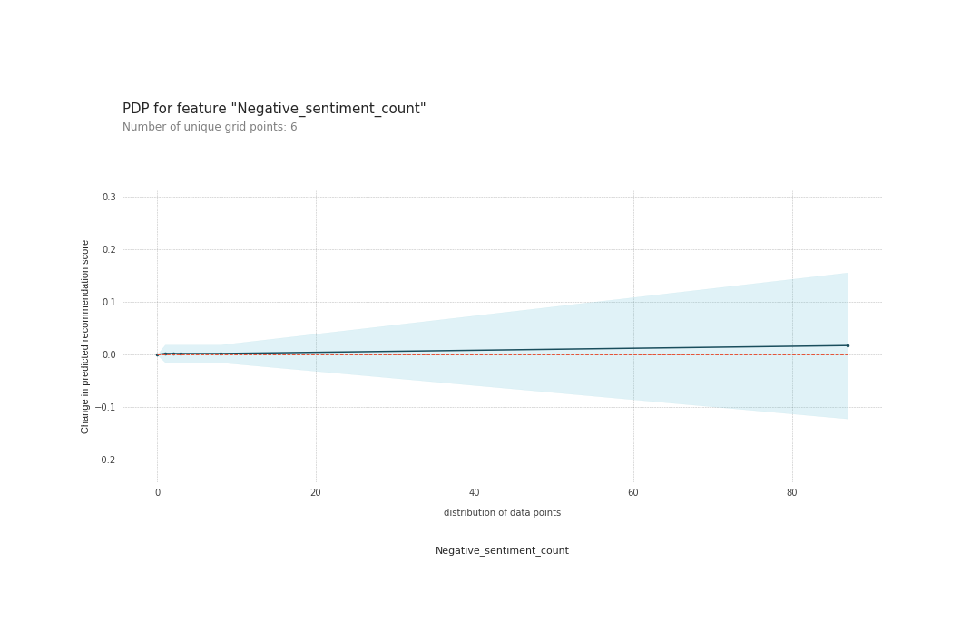
PDP for Positive & Negative sentiment count
Recommendation percent slowly increases till positive count equals 50 and then remains almost constant with increase in count.
Surprisingly in case of negative sentiment, even as negative sentiment count increases the Recommendation percent by the model increases slightly.
But the dependence on sentiment counts is not so significant compared to other important features.

Slide 50
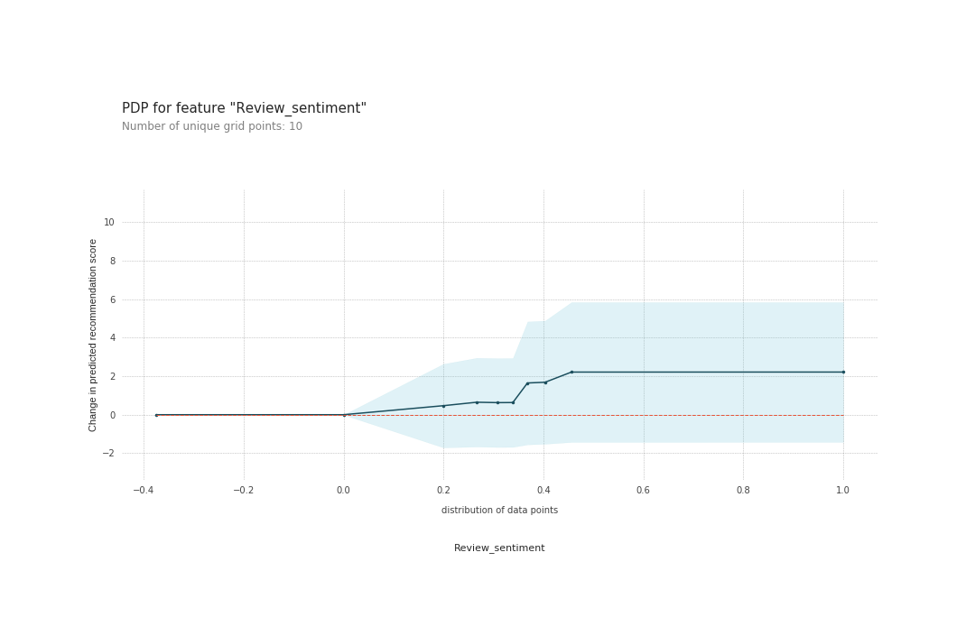
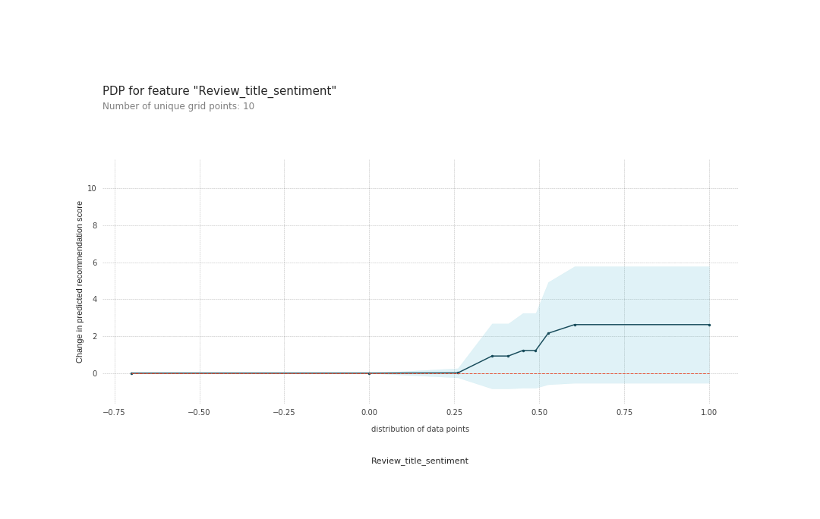
PDP for Review sentiment & Review title sentiment
The Partial Dependence plots are generated using the best performing XGBoost regressor model.
Recommendation percent increases when “review sentiment score” increases beyond 0 .
Similarly , Recommendation percent increases when “review title sentiment score” increases beyond 0.25.
These clearly shows that more positive the review better the recommendation percent by the model.

Slide 51
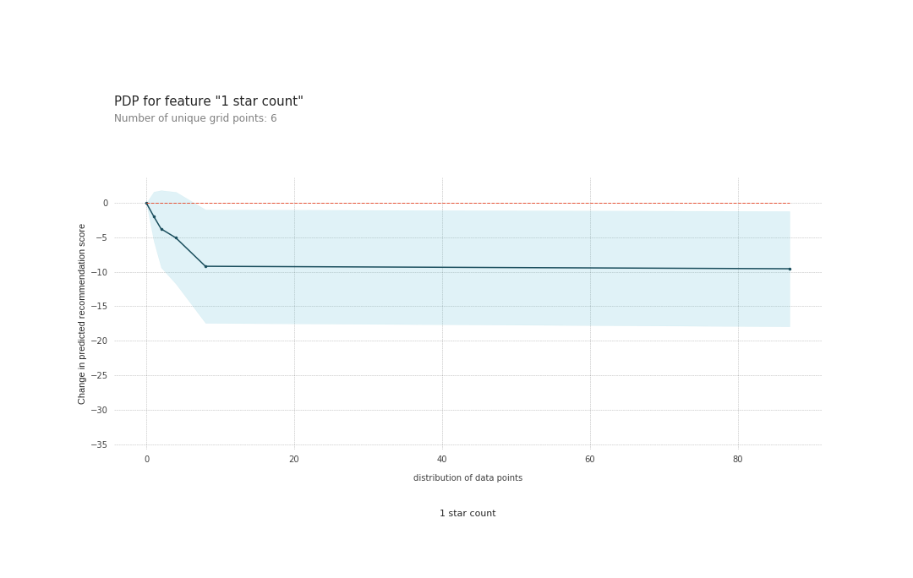
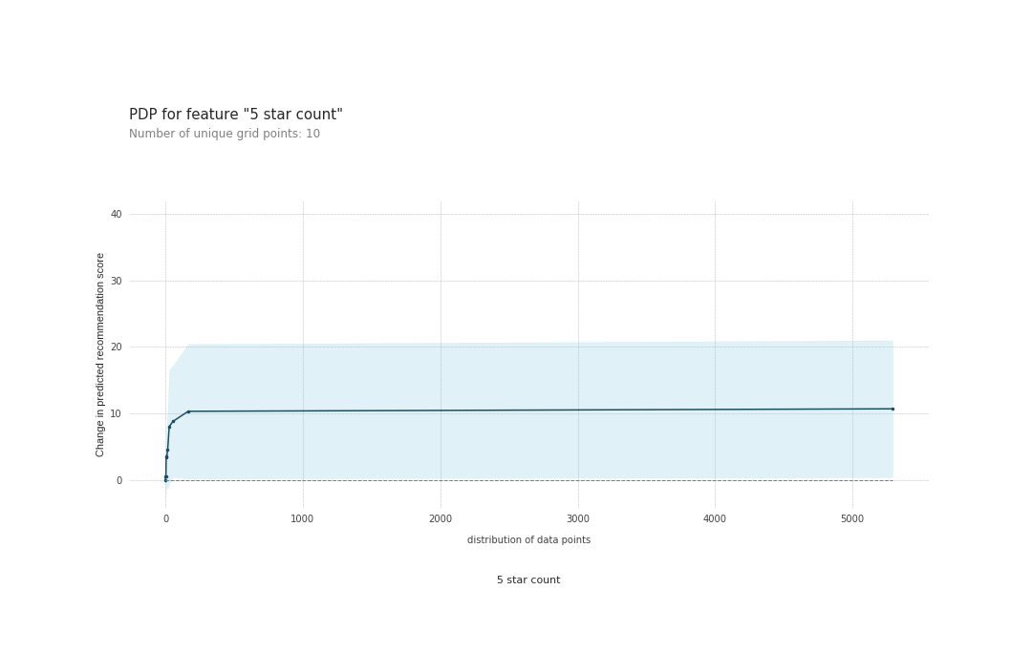
PDP for 1-star count & 5-star count
Recommendation percent decreases significantly when no. of 1-star ratings go beyond 0 till 40 & beyond remains almost constant.
On the other hand , Recommendation percent increases with increase in no. of 5-star ratings.
Similar pattern is observed in other star (2,3,4) ratings.
Based on this we can interpret that higher the product rating, higher the recommendation percent by the model and vice-versa.

Slide 52
Model Interpretation
The Q-Q plot & Histogram of residual values generated by XGBoost regressor on test dataset is plotted. (shown above)
Based on that, we can interpret that the residuals approximately follow a normal distribution.
As the residuals are randomly distributed & follow a normal distribution the XGBoost model is better compared to other models.

